Slide 1
Doing Data Science
Unit 5 Data Wrangling
Dr. Jacquie Cheun
Data Science @ SMU

Slide 2
Admin notes
Live Session Unit 04 assignment due today
Live Session Unit 05 assignment due next Tuesday
Please Upload all assignments on 2DS
Case Study 1 details will be posted by tomorrow

Slide 3
Main topics
Messy data
Regular expressions
Tidy data

Slide 4
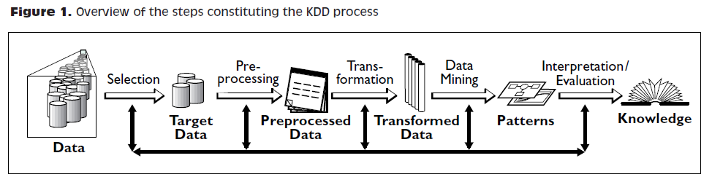
The Data Science Process

Slide 5
Data Munging/Cleaning - Data Janitorial tasks
Numeric/Text transformations:
Normalization, tokenization, remove stop words, filter inconsistent values, impute missing values, numeric values binning
Data transformations:
Convert date formats, enrich with geo data, convert currency, deduplication
Open Source tool: Google Refine http://openrefine.org/

Slide 6
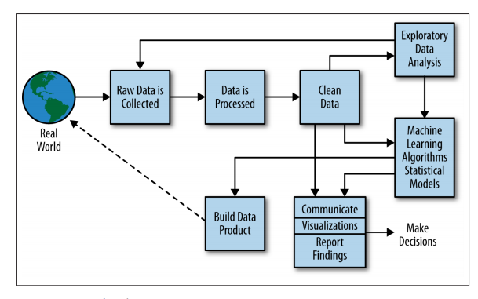
The Data Science Process

Slide 7
Dirty data examples
Naming conventions: TX vs Texas
Parsing text into fields (separator issues)
Missing required field
Different representations (5 vs Five)
Redundant records (exact match etc)
Formatting issues with dates and other metrics
Outliers (e.g., 200 in age column)

Slide 8
Five most common problems with messy data
(Hadley, Wickham, 2014)
also see Tidyr https://blog.rstudio.com/2014/07/22/introducing-tidyr/ & http://r4ds.had.co.nz/tidy-data.html#introduction-6
Column headers are values, not variable names. 
Multiple variables are stored in one column. 
Variables are stored in both rows and columns. 
Multiple types of observational units are stored in the same table. 
A single observational unit is stored in multiple tables. E.g, a separate table of an individual’s medical history for each year of their life.

Slide 9
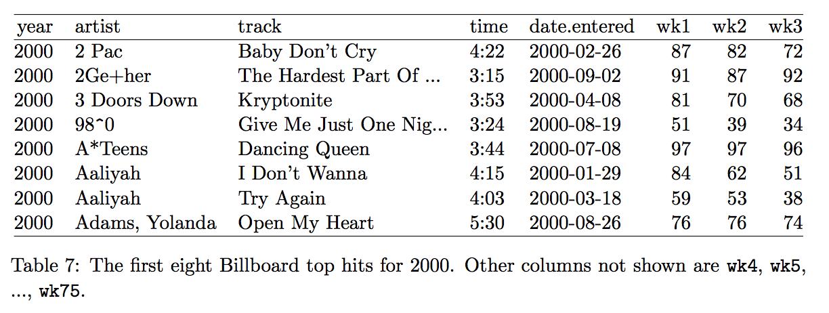
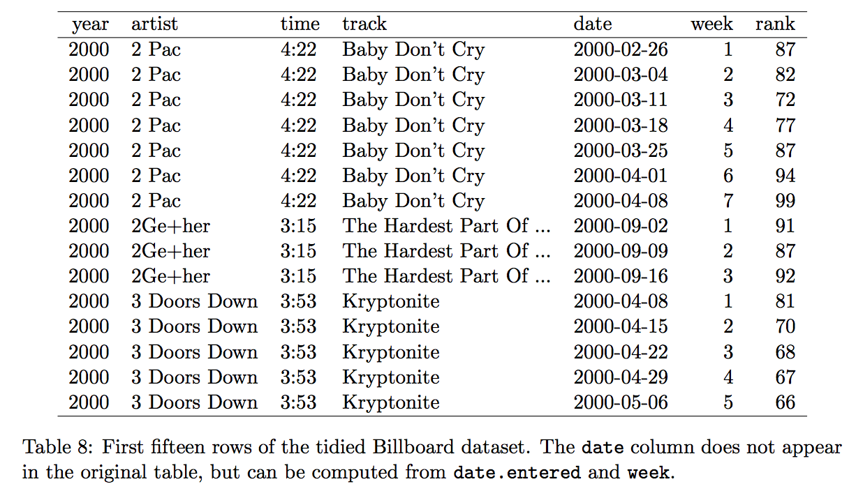
Column headers are values, not variable names
Stack/Melt: turn column into rows
Long vs Wide formats
Tidy data version results in fewer columns but increased duplication.
SQL analogy → data normalization vs denormalization

Slide 10
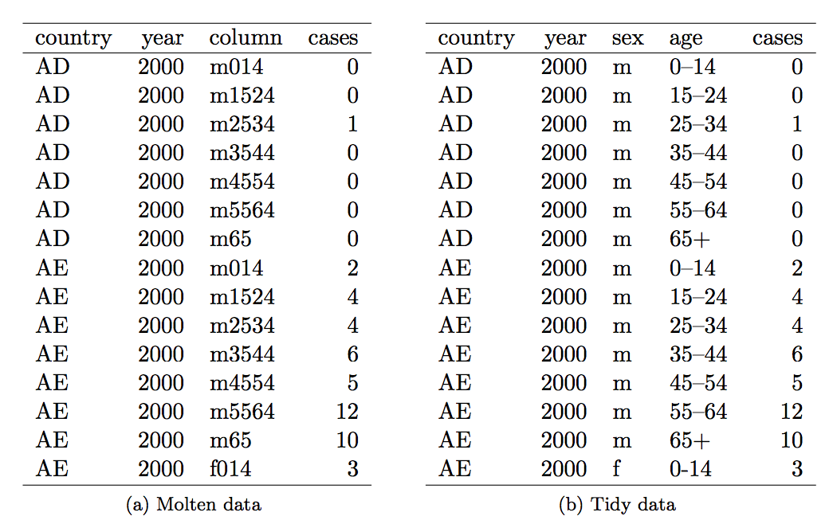
Multiple variables stored in one column
Column is split into sex and age
E.g, M014 → m & 0-14
Usually occurs after a melting operation.

Slide 11
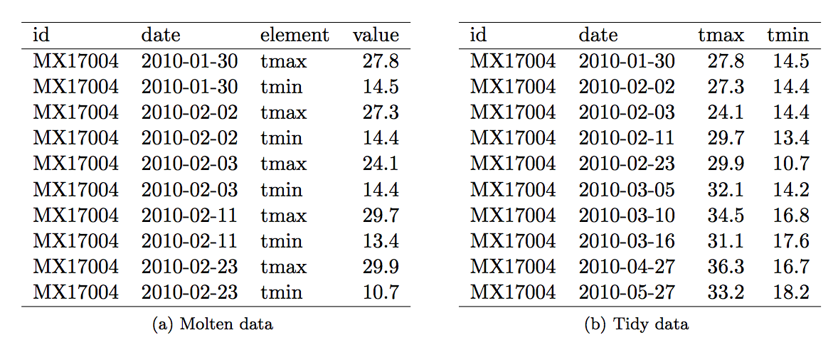
Variables are stored in both rows and columns
Table in a) is “almost” tidy, two variables stored in rows tmin and tmax
Replace element and value with tmax and tmin

Slide 12
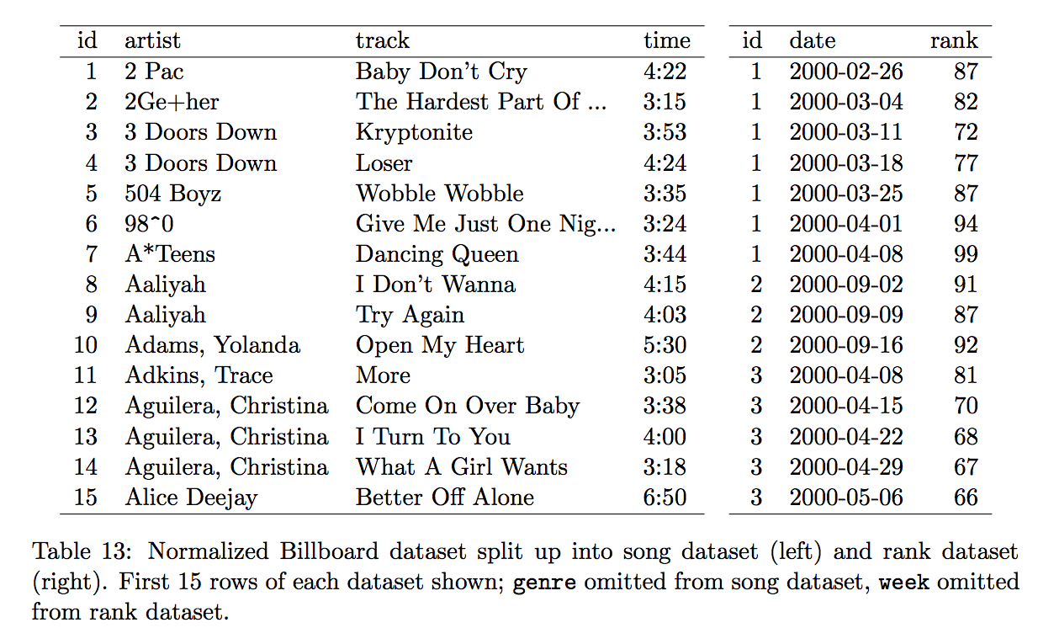
Multiple types of observational units are stored in the same table.
Related to DB normalization.
Relational databases.
Reduce duplication.
Compare Table 13 to Table 8 on slide 9.
Table 8 stores song details and ranking in a single table.

Slide 13
One type in multiple tables
Observations spread over multiple files or tables (e.g., a separate table of an individual’s medical history for each year of their life. )
If the format is consistent, just combine the data into a single table using the plyr package.
Perform additional tidying as needed.
More complex example: https://github.com/hadley/data-fuel-economy
EPA fuel economy data for 50,000 cars from 1978-2008.
Dataset structure also changes over time (inconsistent format)
Requires tidying each file individually before combining into a single dataset.

Slide 14
Regular expressions in R
Origins: Automata theory, theoretical computer science and formal languages
Pattern matching in text editors & lexical analysis in compilers.
Problem: For a dataset of products, find all products which have MX or US as the last two characters of their serial number.

Slide 15
In R: use grep, syntax: grep ([regex], [input vector], ..)
Other options: grep, grepl, regexpr, gregexpr and regexec (differ in format of and amount of detail in the results)
see: https://www.regular-expressions.info/rlanguage.html
Supports many character classes such as [0-9], [a-z], [A-Z], non-digits [^0-9] and many others

Slide 16
(strings <- c("a", "ab", "acb", "accb", "acccb", "accccb"))
grep("ac*b", strings, value = TRUE)
## [1] "ab" "acb" "accb" "acccb" "accccb"
grep("ac+b", strings, value = TRUE)
## [1] "acb" "accb" "acccb" "accccb"
grep("ac?b", strings, value = TRUE)
## [1] "ab" "acb"
grep("ac{2}b", strings, value = TRUE)
## [1] "accb"
grep("ac{2,}b", strings, value = TRUE) what will this return ?
grep("ac{2,3}b", strings, value = TRUE) what will this return ?
Quantifiers:
*: matches at least 0 times.
+: matches at least 1 times.
?: matches at most 1 times.
{n}: matches exactly n times.
{n,}: matches at least n times.
{n,m}: matches between n and m times.
value = True returns matches instead of indices

Slide 17
Pattern positions:
^: matches the start of the string.
$: matches the end of the string.
There are a few more operators but we are focusing on these two
(strings <- c("abcd", "cdab", "cabd", "c abd", "cabdd"))
## [1] "abcd" "cdab" "cabd" "c abd" "cbdd"
grep("ab", strings, value = TRUE)
## [1] "abcd" "cdab" "cabd" "c abd" "cbdd"
grep("^ab", strings, value = TRUE)
## [1] "abcd"
grep("ab$", strings, value = TRUE)
## [1] "cdab"
grep("(^c)d?", strings, value = TRUE) → what will this return?
grep("(^c)d+", strings, value = TRUE) → what will this return?

Slide 18
(strings <- c("^ab", "ab", "abc", "abd", "abe", "ab 12"))
grep("ab.", strings, value = TRUE)
## [1] "abc" "abd" "abe" "ab 12"
grep("ab[c-e]", strings, value = TRUE)
## [1] "abc" "abd" "abe"
grep("ab[^c]", strings, value = TRUE)
## [1] "abd" "abe" "ab 12"
grep("^ab", strings, value = TRUE)
## [1] "ab" "abc" "abd" "abe" "ab 12"
grep("\\^ab", strings, value = TRUE) ## [1] "^ab"
grep("abc|abd", strings, value = TRUE) → what will this return?
Operators:
. : matches any single character,
[...] : a character list, matches any one of the characters inside the square brackets.
[^...] : an inverted character list, similar to [...], but matches any characters except those inside the square brackets.
\ : suppress the special meaning of metacharacters
| : an “or” operator, matches patterns on either side of the |.

Slide 19
Gathering & preparing data
Support for importing from other stat packages such as SPSS, SAS, or Stata
library (foreign)
StataData ← read.dta(file=”Data1.dta”)
Data from Secure (https) URLs
library(repmis)
On github every file has a SHA-1 hash which will change if the file is changed → ensures that end users of data are aware of changes.

Slide 20
Use tidyr’s gather function to transform a dataframe from wide to long format (also matrix transpose (t)² and reshape functions in base R)
Use dplyr’s rename function to rename variables:
GatheredFert ← rename(GatheredFert, year = Year, FertilizerConsumption = Fert)
and arrange function to order data (similar to sort order):
GatheredFert ← arrange(GatheredFert, country, year)
Getting subsets of a dataframe using the subset function:
FertOutliers ← subset(x = GatheredFert, FertilizerConsumption > 1000)

Slide 21
Recoding values:
# Recode country == "Korea, Rep."" to "South Korea" GatheredFertSub$country[GatheredFertSub$country == "Korea, Rep."] ←"South Korea"
*note that normalization/classification machine learning approaches are usually used for these in large scale projects
Creating new variables from existing variables:
GatheredFertSub$logFertConsumption ← log( GatheredFertSub$FertilizerConsumption)
(note: may result in -Inf or Inf values for values such as 0.
Solution: recode zeros as 0.001)

Slide 22
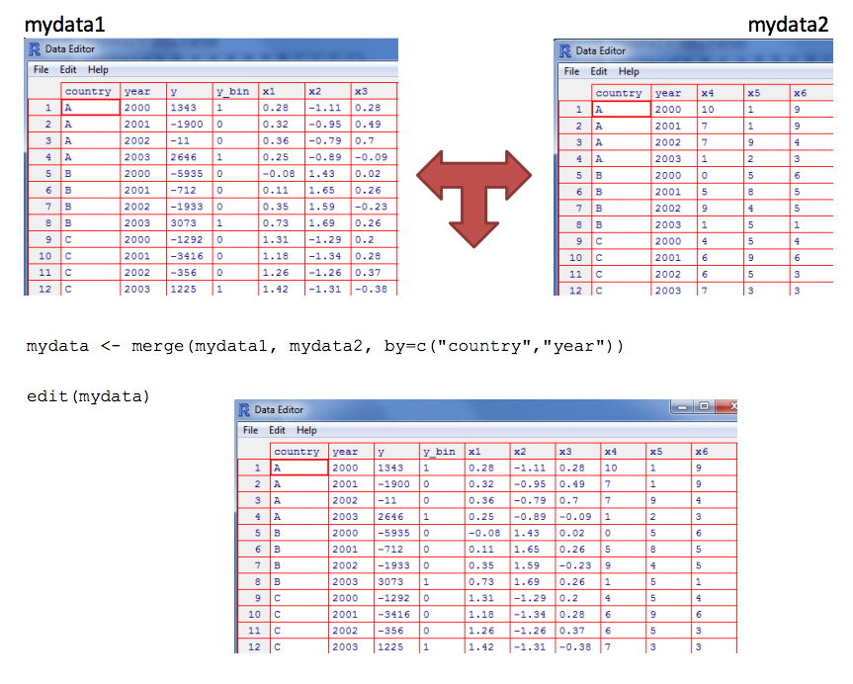
Merge (very similar to a database join): datasets should have at least one variable in common. Parameter all=FALSE (only matching rows are returned) ref. princeton

Slide 23
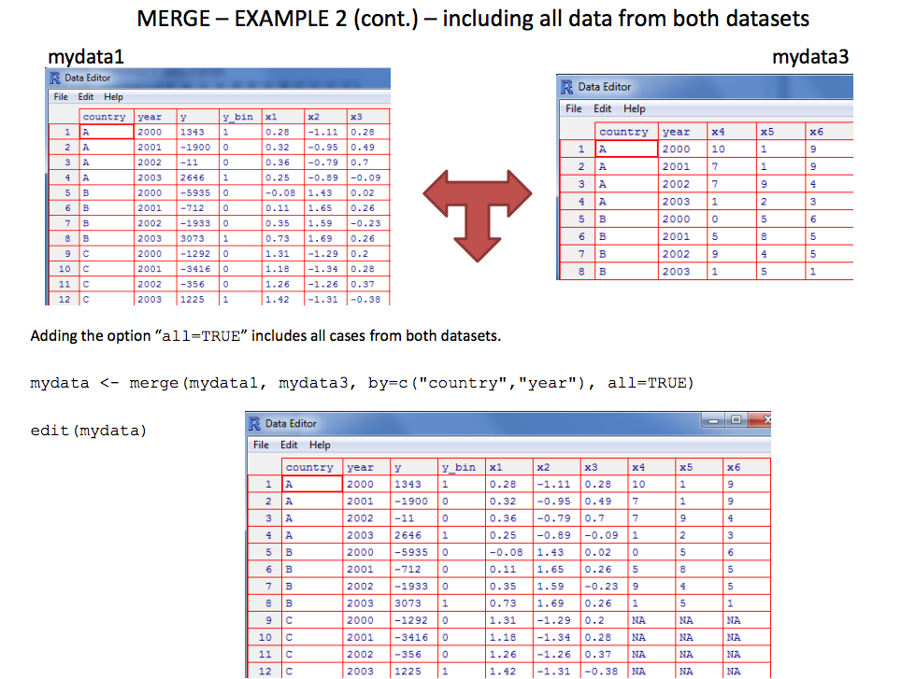
When all=TRUE (include all data from both datasets)

Slide 24
What did you learn today?
Questions?

